Slide 1

Project Two Presentation
DAT-430
Don Zeller
April 16. 2024

Slide 2

Intro: Predictive Analysis of Employee Attrition
Today, we’ll be reviewing the findings from our predictive analysis of employee attrition. Our goal was to uncover factors influencing attrition rates and propose actionable strategies to improve employee retention.
Notes:
Today, we’ll be reviewing the findings from our predictive analysis of employee attrition. Our goal was to uncover factors influencing attrition rates and propose actionable strategies to improve employee retention.

Slide 3

Baseline Attrition Rates and Key Discoveries
Let’s dive in
Notes:
In order to kick off our data analysis efforts, we conducted exploratory data analysis or (EDA) to produce a baseline metric to better understand the problem we are attempting to solve as well as explore our data set to investigate potential causes for employee attrition.

Slide 4
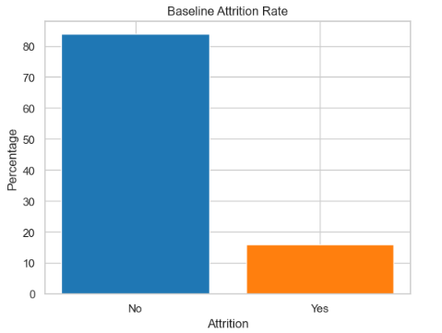
Baseline Attrition Rate
Notes:
Let's start by examining the baseline attrition rate we produced from our exploratory data analysis. As you can see from the chart, approximately 16.12% of employees have left the company, while the remaining 83.88% have stayed.

Slide 5
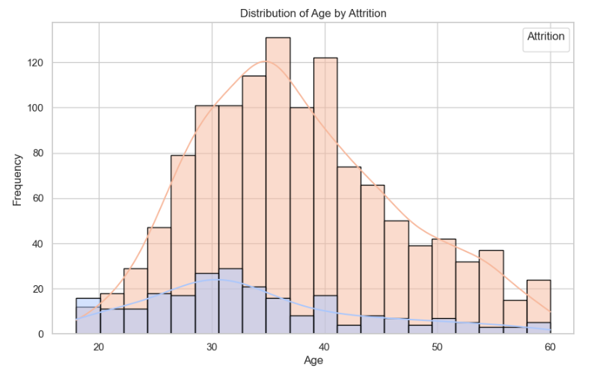
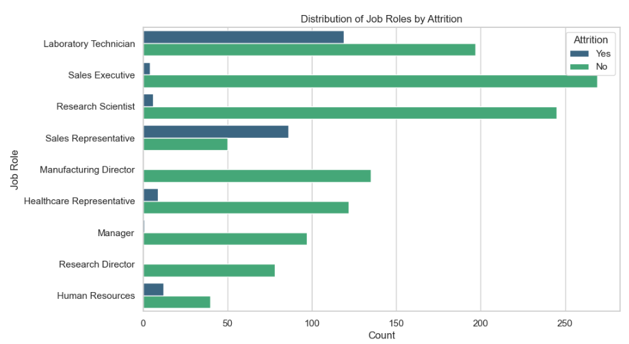
Key Discoveries
Notes:
Through exploratory data analysis, it was observed that there was a significant age difference between employees who left and those who stayed. On average, leavers were younger, with a mean age of about 33.61 years and a median age of 32 years. In contrast, stayers had a higher mean age of approximately 37.56 years, with a median age of 36 years.
We also observed that there were some interesting disparities when it came to job roles; certain roles, such as Laboratory Technicians, Sales Representatives, and Human Resources employees, showed notably higher attrition rates compared to other roles.

Slide 6
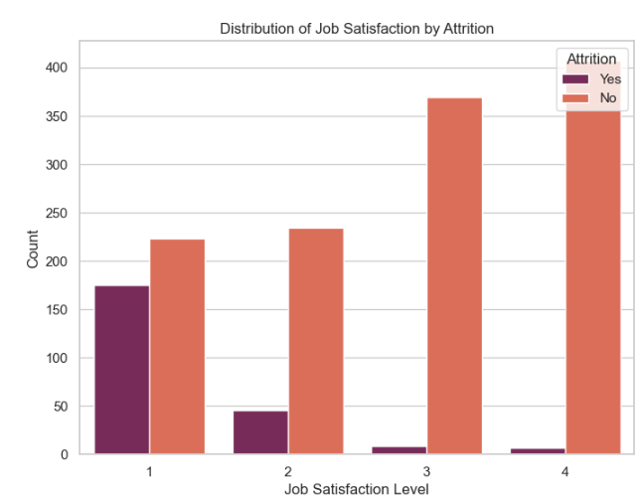
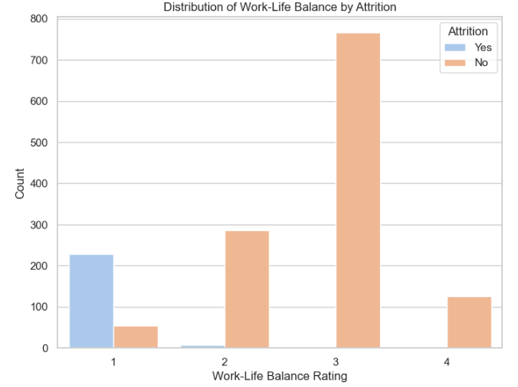
Key Discoveries
Notes:
We also discovered a strong correlation between lower job satisfaction and work-life balance ratings (specifically, ratings of 1 and 2) and higher attrition rates.

Slide 7
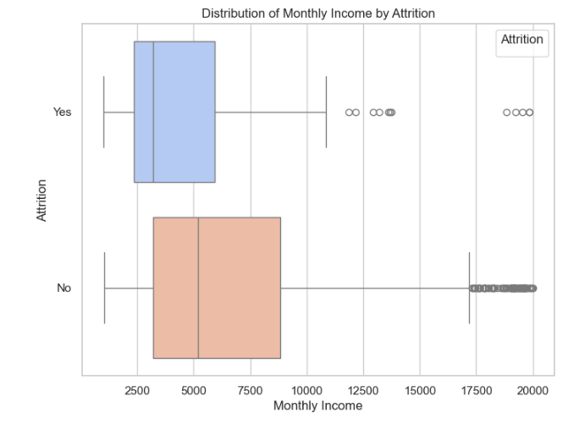
Key Discoveries
Notes:
And finally, income was another significant factor. Employees who left the company had lower average monthly incomes, with a mean of about $4,787, whereas those who stayed had a mean income of around $6,833

Slide 8

Predictive Modeling
Logistic Regression
Notes:
Given the factors we determined were likely to have an affect on employee attrition through our EDA, we engineered these variables as features in our predictive models, specifically: Age, Job Role, Job Satisfaction, Work-Life Balance, and Monthly Income. The first predictive model we will be looking at is our logistic regression model.

Slide 9
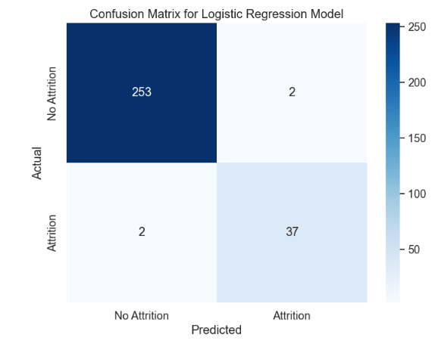
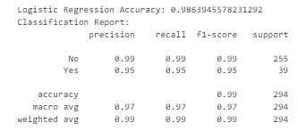
Logistic Regression
Notes:
In our logistic regression model, the focus was predicting employee attrition based on our selected factors (Age, Job Role, Job Satisfaction, Work-Life Balance, and Monthly Income). The logistic regression model was trained using historical data, which means it learned patterns and relationships between the input features (age, job role, job satisfaction, work-life balance, monthly income) and the corresponding outcomes (whether an employee stayed with the company or left) from past observations.
The results of our model show that it achieved an accuracy of approximately 98.64%
Precision and recall for both 'Yes' (attrition) and 'No' (no attrition) categories are high, which indicate good performance for the model.
The confusion matrix(pictured on the left) shows that the model correctly predicted employee attrition 253 times(top-left) and employee retention 37 times(bottom-right). The matrix also shows that the model predicted attrition, but the employee stayed 2 times (top-right) and the model predicted retention, when the employee left 2 times(bottom-left).

Slide 10
Predictive Modeling
Random Forest
Notes:
Our next predictive model is the random forest. This random forest model is used to predict employee attrition based on the same features we chose for our logistic regression model, which are: age, job role, job satisfaction, work-life balance, and monthly income.

Slide 11
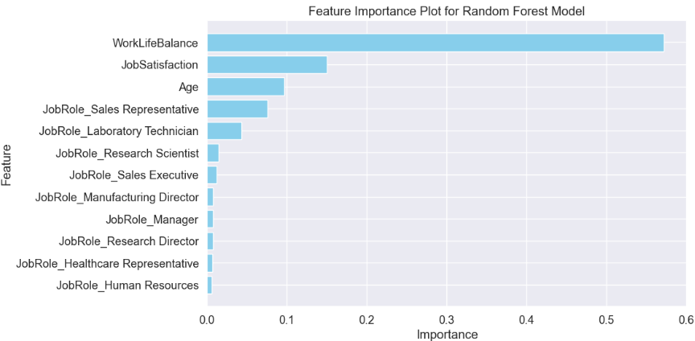
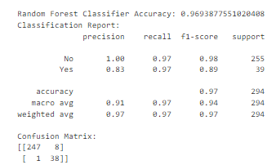
Random Forest
Notes:
We trained our Random Forest model using historical data from the employee attributes: Age, Job Role, Job Satisfaction, Work-Life Balance, and Monthly Income. These features were carefully selected based on their potential impact on attrition.
After rigorous training and evaluation, our model achieved an impressive accuracy score of 96.94% indicating its proficiency in predicting employee attrition.
One of the key insights provided by our Random Forest model is feature importance. This visualization displays the relative significance of each feature in predicting attrition.

Slide 12




Key Conclusions:
Youthful Departures
Employees leaving the company tend to be younger, with a mean age of approximately 33.61 years. This demographic trend suggests a need to explore tailored retention strategies for younger employees.
Role Realignment
Certain job roles, including Laboratory Technicians, Sales Representatives, and Human Resources employees, exhibit higher attrition rates. Addressing challenges specific to these roles could yield significant retention benefits.
Satisfaction
Lower job satisfaction ratings (1 and 2) and work-life balance ratings (1 and 2) are strongly associated with higher attrition rates. Enhancing workplace satisfaction and promoting work-life balance emerge as critical areas for intervention.
Income
Employees who leave the company have lower average monthly incomes, with a mean of approximately $4,787. Exploring equitable compensation structures and opportunities for financial growth may enhance retention efforts.
Notes:
Based on our data analysis and predictive modeling we’ve arrived at a few key conclusions about what potentially contributes to attrition.
Youthful Departure: Our analysis reveals a significant trend: younger employees are more likely to leave the company. This discovery reveals the importance of tailoring any future retention strategies to address the needs and expectations of this demographic.
Satisfaction: Low job satisfaction and work-life balance ratings are also strongly linked to higher attrition rates. Investing in initiatives to enhance workplace satisfaction and promote work-life balance is a key to retaining our valued talent
Role Realignment: Certain job roles, such as Laboratory Technicians, Sales Representatives, and Human Resources employees, exhibit higher attrition rates. This means there should be a need for targeted interventions and support systems tailored to the unique challenges of these roles.
Income: Employees leaving the company tend to have lower average monthly incomes. This calls for a review of our compensation structures to ensure they remain competitive and aligned with employee expectations

Slide 13




Opportunities for Action:
Targeted Retention Programs
Develop targeted retention programs aimed at younger employees, offering mentorship, career development opportunities, and recognition programs to build engagement and loyalty.
Role-Specific Intervention
Implement role-specific initiatives to address challenges faced by employees in high-attrition roles. This could involve job redesign, skill enhancement programs, or improved support systems.
Enhanced Employee Experience
Prioritize initiatives to enhance job satisfaction and work-life balance, such as flexible work arrangements, wellness programs, and regular feedback mechanisms to address concerns proactively.
Compensation Review
Conduct a comprehensive review of compensation structures to ensure they align with market standards and employee expectations. Implement merit-based incentives and career progression pathways to incentivize talent retention.
Notes:
Drawing from the conclusions of our data analysis, we’ve derived specific opportunities for action to increase employee retention rates and lower the attrition rate.
Targeted Retention Programs: Developing targeted retention programs for younger employees, including mentorship, career development, and recognition initiatives, can help build engagement and loyalty among this demographic.
Enhanced Employee Experience: Prioritizing initiatives to enhance job satisfaction and work-life balance, such as flexible work arrangements and wellness programs, can create a positive and fulfilling employee experience which could have a direct impact on employees wanting to stay with the company.
Role-Specific Intervention: Implementing role-specific interventions, such as job redesign and skill enhancement programs, will address challenges faced by employees in high-attrition roles, this could contribute to a more supportive work environment and deter attrition among these roles.
Compensation Review: A comprehensive review of our compensation structures, coupled with merit-based incentives and career progression pathways, can help attract and retain top talent in a competitive market.

Slide 14

Questions?
Engage with us!
We welcome your thoughts, questions, and feedback!
Notes:
Thank you for your attention throughout the presentation. At this stage, I welcome any questions or clarifications you may have regarding the insights, opportunities, or methodology discussed. Our goal is to make sure that there is a thorough understanding of the findings and to address any inquiries you may have about our approach or the implications for our organization.

